Slide 1
The Strange Use Cases of Jupyter Notebook
Gabe Lyu
21/08/2020

Slide 2
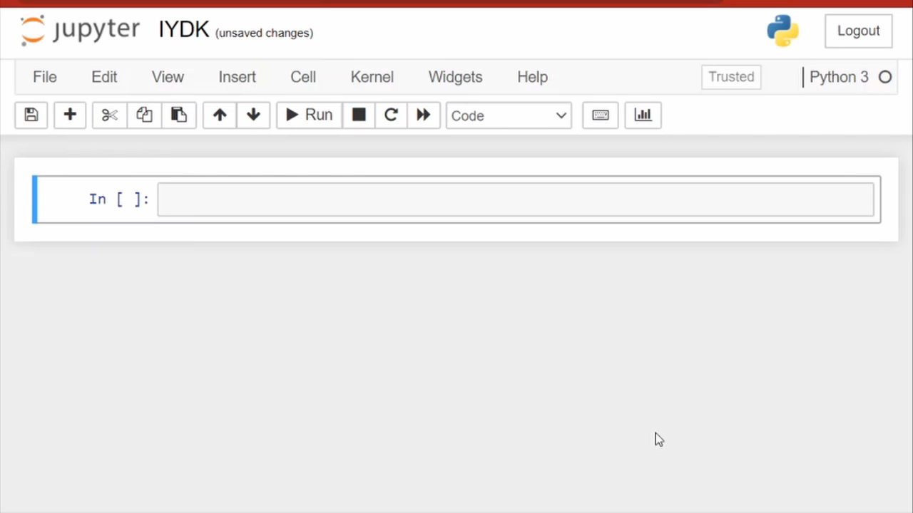
If you don’t know Jupyter Notebook…
Notes:
If you don’t know Jupyter Notebook, think of it as a notebook app that allows you to type and run code in it.

Slide 3
Case 1: Graphical user interface

Slide 4
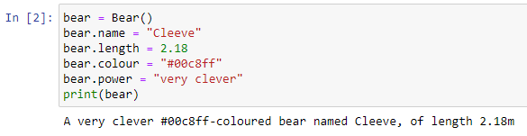
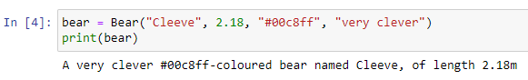
Example: creating a super bear
Notes:
If you use only Jupyter Notebook, you might be thinking of doing these. Neither is suitable for a business analyst.

Slide 5
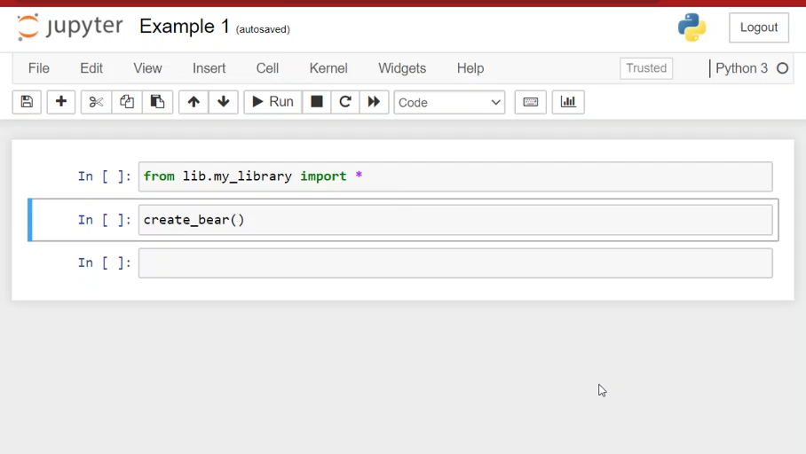
Example: creating a super bear
Notes:
In this example, I wrote a small library so that when I type command create_bear(), it shows me a nice UI for input

Slide 6
Case 2: Canvas vs plots
Notes:
In the next example I will show that you can control your data visualisation with Canvas

Slide 7
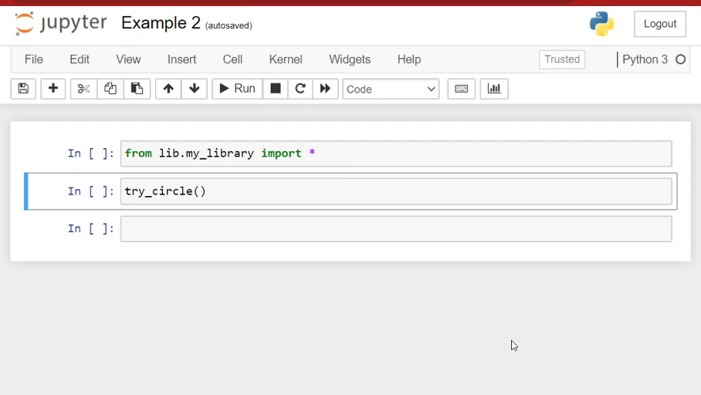
Example: bending a line into a circle
Notes:
In this example, I’m trying to draw a horizontal line as straight as I can. The program will then wrap it into a circle and show if it’s round.

Slide 8
Case 3: Live code in presentation

Slide 9
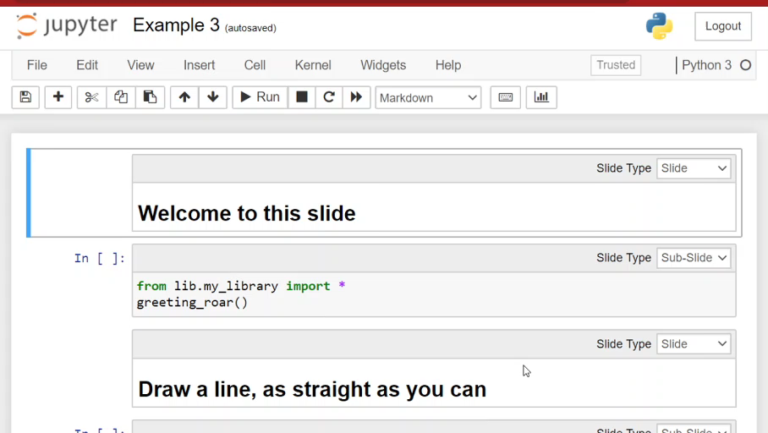
Example
Notes:
In this example I put together previous examples and made it a presentation. I can view the slides and also run the code.

Slide 10
Example
“This entire talk is happening in a Jupyter Notebook”
- Christy Heaton, at PyCon Cleveland 2019
Notes:
Imagine you’re speaking at a conference and starting your talk with this statement.

Slide 11
Conclusion
Three strange use cases of Jupyter Notebook
Graphical user interface
Using canvas with plotting
Presentation with live code
More than a notebook app that runs Python (and Julia and R) code

Slide 12
References
Slides and code
https://github.com/mechbear14/strange-jupyter-notebook
Links
Jupyter Notebook: https://jupyter-notebook.readthedocs.io/en/stable/notebook.html
Widgets (for bear creation example): https://ipywidgets.readthedocs.io/en/stable/examples/Widget%20List.html
IPyCanvas (for line drawing example): https://ipycanvas.readthedocs.io/en/latest/
RISE (for presentation): https://rise.readthedocs.io/en/stable/usage.html
Christy Heaton - Plan your next eclipse viewing with Jupyter and geopandas - PyCon 2019 (presentation mentioned in Case 3): https://www.youtube.com/watch?v=PIPJAE-PXd4

